Slide 1
SYSTEM DESIGN
CHAPTER 4 Assembler
Developed By:
Vivek Vyas
Department of MCA
DDU

Slide 2
Introduction
Translating source code written in assembly language to object code.

Slide 3
Language Levels
High Level Language
Assembler Language
Machine Language
Micro -programming
Firmware
Hardware

Slide 4
Introduction
Machine code:
Set of commands directly executable via CPU
Commands in numeric code
Lowest semantic level

Slide 5
Introduction
Machine code language
Structure:
Operation code
Defining executable operation
Operand address
Specification of operands
Constants/register addresses/storage addresses
OpCode
OpAddress

Slide 6
4.1 Elements of Assembly Language Programming
An Assembly language is a
machine dependent,
low level Programming language specific to a certain computer system.
Three features when compared with machine language are
Mnemonic Operation Codes
Symbolic operands
Data declarations

Slide 7
4.1 Elements of Assembly Language Programming
Mnemonic operation codes: eliminates the need to memorize numeric operation codes.
Symbolic operands: Symbolic names can be associated with data or instructions. Symbolic names can be used as operands in assembly statements.
Data declarations: Data can be declared in a variety of notations, including the decimal notation (avoids conversion of constants into their internal representation).

Slide 8
4.1 Elements of Assembly Language Programming
Assembly language-structure
Label
symbolic labeling of an assembler address (command address at Machine level)
Mnemomic
Symbolic description of an operation
Operands
Contains of variables or addresse if necessary
Comments
<Label>
<Mnemomic>
<Operand>
Comments

Slide 9
4.1 Elements of Assembly Language Programming
Statement Format
An Assembly language statement has following format:
[Label] <opcode> <operand spec>[,<operand spec>..]
If a label is specified in a statement, it is associated as a symbolic name with the memory word generated for the statement.
<operand spec> has the following syntax:
<symbolic name> [+<displacement>] [(<index register>)]
Eg. AREA, AREA+5, AREA(4), AREA+5(4)

Slide 10
4.1 Elements of Assembly Language Programming
Instruction has two operands
First is always register out of AREG, BREG, CREG, DREG
Second can be memory location as symbolic name or offset.
eg: MOVER AREG, SUM

Slide 11
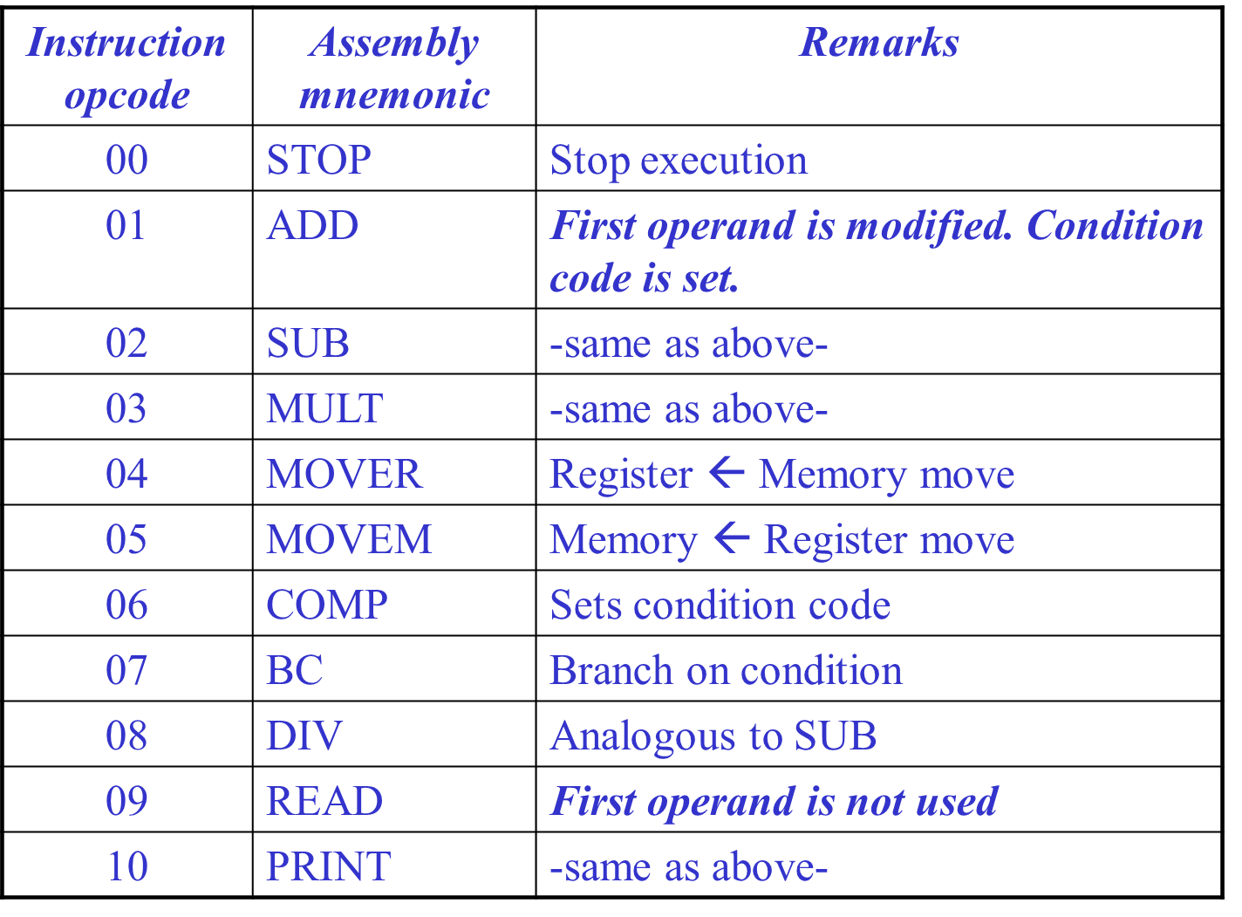
4.1 Elements of Assembly Language Programming

Slide 12
4.1 Elements of Assembly Language Programming
The MOVE instruction move a value between a memory word and register.
In the MOVER instruction the second operand is the source operand and first operand is the target operand.
MOVEM – first operand is source, second is target
All arithmetic performed in a register and sets a condition code.
The condition code can be tested by Branch of Condition (BC) instruction.

Slide 13
4.1 Elements of Assembly Language Programming
The assembly statement corresponding to it has the format
BC <condition code spec>, <memory address>
It transfer control to the memory word with the address < memory address > if the current value of condition code matches < condition code spec >.
Condition code spec – LT LE EQ GT GE ANY
1 2 3 4 5 6

Slide 14
4.1.1 Assembly Language Statements
An assembly program contains three kinds of statements:
Imperative statements.
Declarative statements.
Assembler statements.

Slide 15
Imperative statements
Indicates an action to be performed during the execution of the assembled program.
Each imperative statement typically translates into one machine instruction.
eg: ADD, MULT

Slide 16
Declarative statements
The syntax of declaration statement is as follows:
[Label] DS <constant>
[Label] DC ‘<value>’
The DS (Data Storage) statement reserves area of memory and associates names with them.
Eg:
A DS 1
G DS 200

Slide 17
Declarative statements
A reserves a memory area of 1 word and associates the name A with it. G is associated with the first word of the block.
Other words in the block can be accessed through offsets from G eg. G + 5 is the sixth word of the memory block etc.
The DC (declare constant) statement constructs memory words containing constants. The statement
ONE DC ‘1’
associates the name ONE with a memory word containing the value ‘1’.

Slide 18
Assembler Directive
Assembler directives instruct the assembler to perform certain actions during the assembly of a program.
Some assembler directives are described in the following:
1) START <constant>
This directive indicates that the first word of the target program generated by the assembler should be placed in the memory word having address <constant>.
2) END [<operand spec>]

Slide 19
Assembler Directive
This directive indicates the end of the of the source program. The optional <operand spec> indicates the address of the instruction where the execution of the program should begin

Slide 20
4.2 A simple Assembly Scheme
Design Specification of an assembler
There are four steps involved to design the specification of an assembler:
Identify information necessary to perform a task.
Design a suitable data structure to record info.
Determine processing necessary to obtain and maintain the info.
Determine processing necessary to perform the task

Slide 21
4.2 A simple Assembly Scheme
There are two phases in specifying an assembler:
Analysis Phase
Synthesis Phase(the fundamental information requirements will arise in this phase)

Slide 22
Synthesis Phase
Consider the following statement:
MOVER BREG, ONE
The following info is needed to synthesize machine instruction for this statement:
Address of the memory word with which name ONE is associated [depends on the source program, hence made available by the Analysis phase].
Machine operation code corresponding to MOVER [does not depend on the source program but depends on the assembly language, hence synthesis phase can determine this information for itself]

Slide 23
Synthesis Phase
Symbol Table --built by the analysis phase
The two primary fields are name and address of the symbol used to specify a value.
Mnemonics Table --already present
The two primary fields are mnemonic and opcode, along with length.
Synthesis phase uses these tables to obtain
The machine address with which a name is associated.
The machine op code corresponding to a mnemonic.
The tables have to be searched with the
Symbol name and the mnemonic as keys

Slide 24
Analysis Phase
Primary function of the Analysis phase is to build the symbol table.
It must determine the addresses with which the symbolic names used in a program are associated
It is possible to determine some addresses directly like the address of first instruction in the program (ie.,start)
Other addresses must be inferred
To determine the addresses of the symbolic names we need to fix the addresses of all program elements preceding it through Memory Allocation.
To implement memory allocation a data structure called location counter is introduced.

Slide 25
Analysis Phase
Analysis Phase – Implementing memory allocation
LC(location counter) :
is always made to contain the address of the next memory word in the target program.
It is initialized to the constant specified at the START statement.
When a LABEL is encountered,
it enters the LABEL and the contents of LC in a new entry of the symbol table.
LABEL – e.g. N, AGAIN, SUM etc
It then finds the number of memory words required by the assembly statement and updates the LC contents

Slide 26
Analysis Phase
Analysis Phase – Implementing memory allocation
To update the contents of the LC, analysis phase needs to know lengths of the different instructions
This information is available in the Mnemonics table and is extended with a field called length
We refer the processing involved in maintaining the LC as LC Processing

Slide 27
Analysis Phase
Example
START 100
MOVER BREG, N LC = 100 (1 byte)
MULT BREG, N LC = 101 (1 byte)
STOP LC = 102 (1 byte)
N DS 5 LC = 103
Symbol | Address
N | 103

Slide 28
Analysis Phase
Since there the instructions take different amount of memory, it is also stored in the mnemonic table in the “length” field
Mnemonic | Opcode | Length
MOVER | 04 | 1
MULT | 03 | 1

Slide 29
Data structures of an assembler During analysis and Synthesis phases
Mnemonic | Opcode | length
ADD | 01 | 1
SUB | 02 | 1
Mnemonic Table
Analysis Phase
Synthesis
Phase
Target
Program
Source
Program
--------------------------------->
Symbol | Address
N | 104
AGAIN | 113
Data Access
-- > Control Access
Symbol Table

